Slide 1
Quest For Employment
The Director’s Cut of the Job Search

Slide 2
I’m Steven Savage
I like to call myself a “Professional Geek.”
I’ve been a Project Manager for 9 years. Before that I was an engineer for 7 years.
I speak, write, and blog on careers, economics, culture, and technology. I like to think I have the time to do this as I’m so organized.
You’ve seen me around and may have attended my previous panel on video games and PMs.

Slide 3
So why am I flapping my jaw again?
I got laid off twice in 2012, and had to do two job searches, as well as control my disillusionment with startups.
I decided to record my job search findings and techniques as a way of learning, a way of sharing, and as a way to make something good come of this besides a paycheck.
I ended up putting these findings in a book, Quest For Employment, at http://www.questforemployment.com/

Slide 4
What Did I Discover?
First, that Yorkshire Terriers find you boring to watch when you do a job search.
Two, that the basic job search techniques and skills we’re taught are just that – basic. There’s more.
Three, that there’s identifiable ways to improve your job search beyond the basic – “The Director’s Cut” as it were.
Fourth, that I can put this in a book, sell it, and get PDU’s for discussing a Red Bull fueled job search.

Slide 5
So What Areas Can We Improve?
Dealing with Regional Issues.
Know How Your Resume Communicates.
How Job Search Boards Can Help.
What Networking Really Is.
Being your (Best) Self.
Empathy Is Success.
A “Blitz” Can Help You Get Going.
The Job Search is a Campaign.

Slide 6
So Let’s Get Going!
We’ll look at each section in detail and what you can do. After all we’re not getting any more employed sitting here!

Slide 7
Dealing With Regional Issues
Location, Location, Frustration

Slide 8
Regional Differences Can Be Radical
Differences occur in jobs, requirements, and responsibilities by country, by coast, by state, and even by city.
These differences can be subtle or blatant, but we’re often not aware of them either way – because it’s easy to assume things are the same.
Even in areas near each other, there can be startling regional differences.
Realizing these differences can be an edge in your search.

Slide 9
You Should . . .
Understand Job Titles between regions.
Understand which search tools work for which areas.
Understand the value of your experience for different areas.
Get to know a region to show knowledge of an area in interviews.
Find what attitude works for you in what region.

Slide 10
Know How Your Resume Communicates
Is There a Silver Bullet Point?

Slide 11
Resumes Say More Than We Think
People can judge a lot about you before they read a resume.
A resume’s look, format, clarity, layout, and more speak of a level of skill and commitment.
A good resume shows you care about the recruiter and the people reading it.
People are so used to bad resumes that good ones stand out and are appreciated.

Slide 12
You Should . . .
Make your resume look good and professional – it shows your commitment.
Make it interesting and make it tell a story – engage people.
Keep in mind this resume has to help people hire you – you help them by making it clear and well-done.
Remember making a resume is a separate skill – treat it that way.

Slide 13
How Job Search Boards Can Help
It’s not just reading postings until your eyes bleed.

Slide 14
Job Search Boards Work – Kind Of
Boards get good and bad reps, but they need to be understood for what they are.
Board effectiveness varies radically by region, position, and industry. It can be more effective than Networking – or useless.
Their usefulness changes over time.
They are, actually, great research tools.

Slide 15
You Should . . .
Identify good job boards for your search (if there are any), and swap tips with others.
Follow any leads with one company to see if there are others – Boards can signal larger bodies of opportunities.
Use Boards for research to see what’s out there, what you can learn, trends, etc.
Company boards usually have posts that aren’t anywhere else – use your alerts.
Boards will also introduce you to good recruiters.

Slide 16
What Networking Really Is
If you think it’s all about cables, I have news for you.

Slide 17
Networking Is More Than It Seems
Networking is something we give lip service too, and often get tired of hearing about.
What it really is is developing the ability to communicate and connect with people – and doing it all the time.
We often treat it as something we turn on and off or are forced to do – really you have to get into it.
It’s a long-term commitment.

Slide 18
You Should . . .
Tell people about your job search and job search needs. They have to know or they can’t help.
You are always networking. Even in an interview, your networking skills help you connect.
Remember networking is about connecting with everyone, from recruiters to secretaries.
Remember Networking is arguably the most effective way to find the right job, but not the only one.

Slide 19
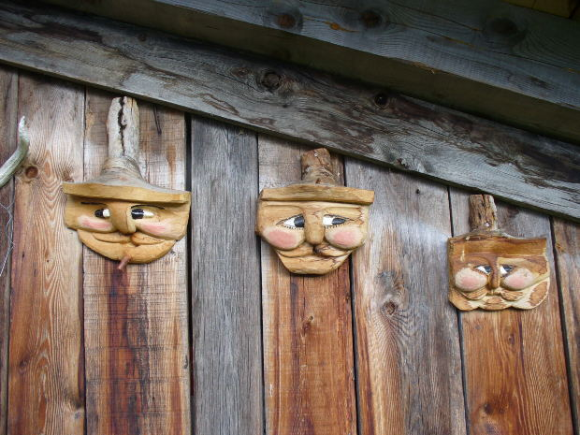
Being your (Best) Self
It’s not who you know, it’s who you know you are.

Slide 20
You Want To Be Yourself
Being false on the job search leads to failure.
A lot of people in the job search spend too much time dancing around the truth about each other.
The best thing to do is to be yourself – by showing the best “sides” of you.
The self-exploration this entails is very helpful.

Slide 21
You Should . . .
Spend some time getting to know yourself so you can be more authentic.
Identify and bring out your best traits in interviews – and bring them up.
Be honest. It’s better you don’t get a job you’re wrong for than have a miserable career.
Being your Best Self makes you more relaxed and natural.

Slide 22
Empathy Is Success
Someone has to stop being a jerk. You should start.

Slide 23
Empathy Is Lacking In The Job Search
There’s a lot of hostility.
There’s a lot of misunderstanding.
There’s a lot of stress.
When we’re more empathetic with the people we interview with and talk to, we communicate better and we make it easier.
Empathy makes us better interviewers.

Slide 24
You Should . . .
Put yourselves in the shoes of people interviewing you.
Ask what your potential employer wants and needs – it’ll help you communicate it.
Really connect with people in the job search – make the effort to find common ground.
Understand that as much as it’s awful for you, some poor sot has to interview a hundred of you.

Slide 25
A “Blitz” Can Help You Get Going
Grab the coffee and get going

Slide 26
Starting the Job Search Is Hard
You’re tired, exhausted, depressed, and possibly coping with anger issues.
You need to feel effective and get moving.
It seems to be best to start off with a “Blitz” – jump straight into it.
It makes you feel effective, gives you feedback, and helps you focus.

Slide 27
You Should . . .
Make sure you know what you want first.
Contact EVERYONE you know to tell them your situation – someone can help.
Get as many resumes out there – I recommend sending them out to every job board and opening you can find.
Watch the results as the feedback comes back – it helps you evaluate your situation.
It also “gets things out of the way.”

Slide 28
The Job Search is a Campaign
In for the long haul, no matter how short it is.

Slide 29
A Job Search Should Be A Campaign
Being organized, having regular reviews and activities lets you stay organized and be effective.
A well-organized job search helps you best use your time.
It controls the panic of a job search.
It helps you evaluate feedback.

Slide 30
You Should . . .
Make sure you have your “materials” in order – resume, etc. Before any search is needed.
Track your data to evaluate performance, opportunities, etc.
Regularly review progress and information so you can adapt.
“Hit Hard” – get those resumes and contacts out there.
Go around, don’t give up – this is navigation.
Tie it together – introduce people, etc.

Slide 31
In Conclusion
Amazing how long he can talk isn’t it?

Slide 32
Go Beyond The Basics
What we’re often taught about job searching is the basics.
We might not learn about the “Directors Cut” for a long time – or know we know it.
Job Searching is its own skillset and knowledge set – and is worth developing.
This would be somewhat less worrysome if the economy didn’t continue to be pathetic.

Slide 33
Your Instructions
Follow the advice here.
When you do your next epic job search share it – in a blog, as a seminar, in a video etc.
Go on and publish a book (call me for advice!) or something else.
Every effort we make can be shared to help us all be better at navigating these changing times.

Slide 34
Contact Me!
I can be reached at http://www.stevensavage.com/
I’m always glad to hear from fellow pros!
You can find my books on Amazon, Nook, and my own site.

